Slide 1


Data is a gathered body of facts
Data is the central thread of any activity
Understanding the nature of data is most fundamental for proper and effective use of statistical skills
1

Slide 2


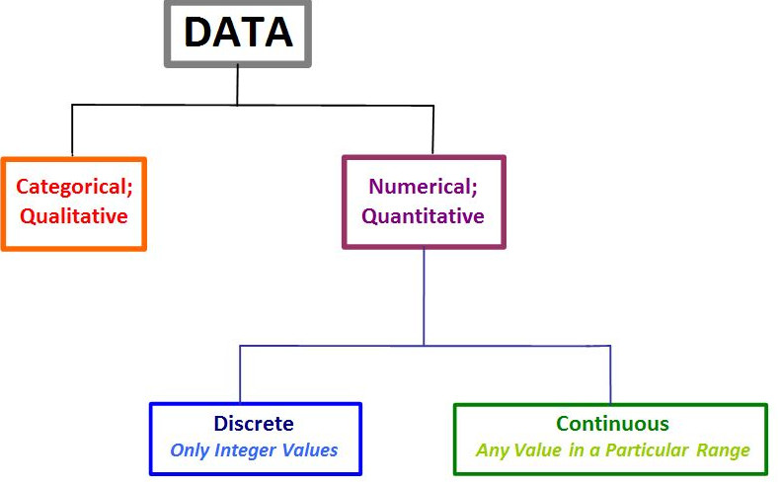
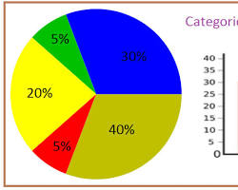
Quantitative data: This type of data is numerical and can be measured along a scale. Examples of quantitative data include temperature, weight, and height.
Qualitative : customer satisfaction with a product can be rated as excellent, good, fair, poor.
Categorical : distinct categories. For instance, hair color can be categorized as blonde, brunette, redhead
Discrete data: Consists of whole numbers (integers).
.number of apples in a basket or the number of customers in a store
Continuous Data:
Can take any value within a range.
Examples: Temperature, height, weight, etc.

Slide 3
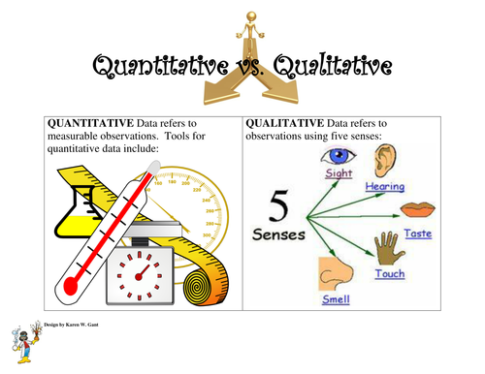

Slide 4
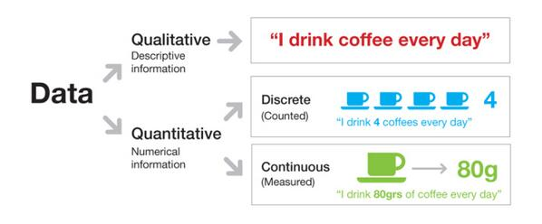

Slide 5
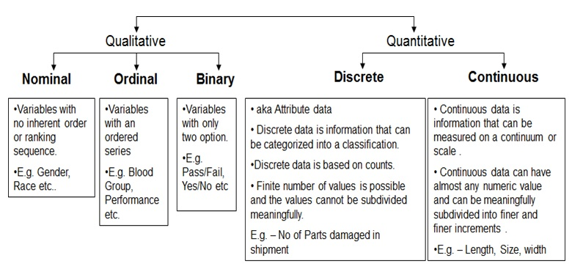
Hair color (blonde, brunette, redhead)Blood type (A, B, AB, O)
Nationality (American, French, Chinese)
Movie ratings (1 star, 2 stars, 3 stars)Education levels (high school diploma, bachelor's degree, master's degree, Ph.D.)Military rank (private, corporal, sergeant, etc.)

Slide 6
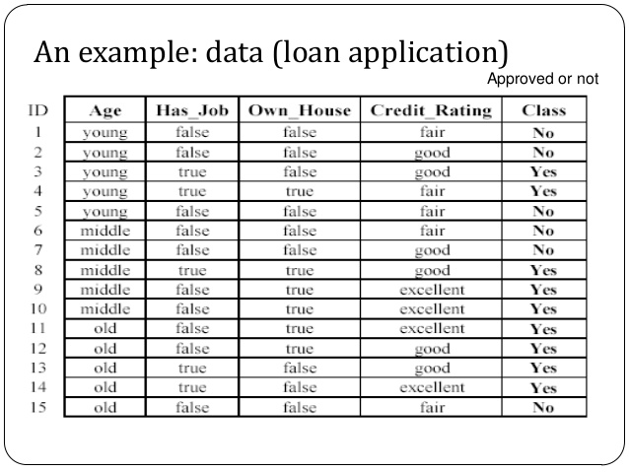

Slide 7
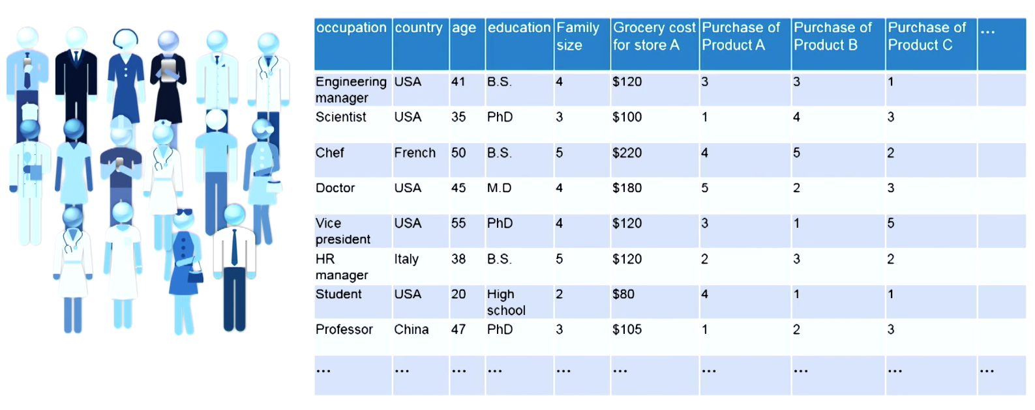

Slide 8

Based on their mathematical properties, data are divided into four groups: NOIR
Nominal
Ordinal
Interval
Ratio
They are ordered with their increasing
accuracy
powerfulness of measurement
preciseness
wide application of statistical techniques
8

Slide 9

Nominal means name and count; data are alphabetic or numerical in name only
They are categories without order or direction
Their use is restricted to keeping track of people, objects and events
They are least powerful in measurement with no arithmetic origin, order, direction or distance relationship
Hence nominal data is of restricted or limited use

Slide 10


Gender, marital status or any alphabetic/ numeric code without intrinsic order or ranking
Sl. No. | Subject | Code
1 | Physics | P
2 | Chemistry | C
3 | Mathematics | M
4 | Biology | B

Slide 11

Ordinal Data
Ordinal means rank or order
Ordinal data place events in order; They are ordered categories like rankings or scaling
Ordinal data allows for setting up inequalities and nothing much
Adjacent ranks need not be equal in their differences
Has no absolute value (only relative position in the inequality)
More precise comparisons are not possible

Slide 12


Ranks or grades of students; Quality rating of service or product
Sl. No. | Education | Code
1 | Undergraduate | U
2 | Graduate | G
3 | Postgraduate | P
4 | Doctorate | D
The inequalities like U < G < P < D does not help to know differences between any two of them cannot be said to be same (say, difference between U and G is not same as G and P)

Slide 13





Interval data in addition to ranking (setting up inequalities) further allow for forming differences
For interval data there is no absolute zero; unique origin does not exists
Interval data are more powerful than ordinal scale due to equality of intervals
Examples:
Temperature in Fahrenheit, Standardised scores

Slide 14


Ratio data allow for forming quotients in addition to setting up inequalities and forming differences
All mathematical operations (manipulations with real numbers) are possible on ratio data
It can have an absolute or true zero and represent the actual amount/ value
The most precise data and allow for application of all statistical techniques
Examples:
Height, weight, age

Slide 15

Unlike ratio data (like height or weight where zero represents a complete absence), interval data has an arbitrary zero point. This means zero on the scale doesn't necessarily correspond to a complete absence of the quantity being measured.
Example: Zero degrees Celcius doesn't indicate the absence of heat, just a specific point on the temperature scale.

Slide 16

Roll No. | Name | Gender | Rank | Height | Weight In Kgs
1 | Amar | M | 9 | 4’ 8” | 51
2 | Asha | F | 1 | 3’ 10” | 39
3 | Bhaskar | M | 5 | 4’ 5” | 48
4 | Chandru | M | 3 | 4’ 3” | 41
Types of data
11

Slide 17
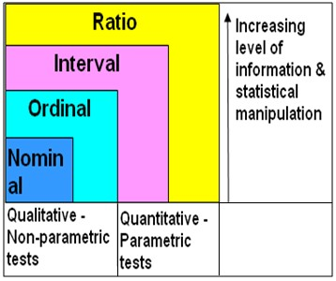
Relation among data types

Slide 18
Discrete and Continuous Data
Numerical data could be either discrete or continuous
Continuous data can take any numerical value (within a range); For example, weight, height, etc.
There can be an infinite number of possible values in continuous data
Discrete data can take only certain values by a finite ‘jumps’, i.e., it ‘jumps’ from one value to another but does not take any intermediate value between them (For example, number of students in the class)

Slide 19
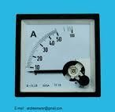
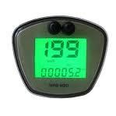
A good example to distinguish discrete data from continuous data is digital and analogue meter or clock where digital is discrete and analog is continuous

Slide 20

Continuous data is more precise than discrete
Continuous data is more informative than discrete
Continuous data can remove estimation and rounding of measurements
Continuous data is often more time consuming to obtain
Discrete should also be converted to continuous data when possible as to obtain a higher level of information and detail

Slide 21
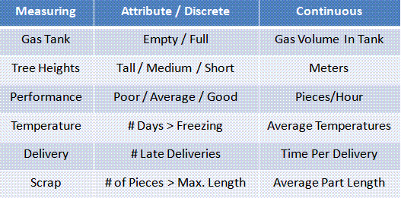
Examples of conversion of discrete to continuous data
Types of data
18

Slide 22
1. pandas (Powerful Data Analysis and Structures):
Data Structures for Analysis: pandas builds upon NumPy and offers specialized data structures like Series (one-dimensional) and DataFrames (two-dimensional labeled data) for easier data manipulation and analysis.
Data Loading and Cleaning: pandas provides tools for loading data from various sources (CSV, Excel, SQL databases) and cleaning it (handling missing values, duplicates, etc.).
Example: You can use pandas to read a CSV file containing temperature data, remove rows with missing values, and calculate summary statistics for each month.
Pandas read CSV, Excel file, JSON, Parquet and other types of files.
https://www.kdnuggets.com/introduction-to-numpy-and-pandas#:~:text=Pandas%20is%20built%20on%20Numpy,a%20column%20of%20the%20dataframe.
Types of data
18

Slide 23
2. NumPy (Numerical Python)
Foundation for Numerical Data:
NumPy is the bedrock for numerical computing in Python.
It provides powerful multidimensional arrays and efficient mathematical functions.
Operations on Large Datasets: NumPy arrays are optimized for speed and memory usage, making them ideal for handling large datasets.
Example: You can use NumPy to perform calculations on entire columns of temperature data in a single operation.
Types of data
18

Slide 24
3. Matplotlib (Plotting and Visualization)
Creating Static Visualizations: Matplotlib is a versatile library for creating various plots like line charts, histograms, scatter plots, and more.
Customization and Control: It offers a high degree of customization for plot appearance, labels, and legends.
Example: You can create a line chart in Matplotlib to visualize the average temperature over time.
Types of data
18

Slide 25
4. Seaborn (Statistical Graphics on top of Matplotlib)
Seaborn builds upon Matplotlib: Seaborn is a higher-level library built on top of Matplotlib.
It provides a more user-friendly interface for creating statistical graphics commonly used in data exploration and analysis.
Focus on Statistical Plots: Seaborn offers a variety of pre-built functions for creating distribution plots, violin plots, heatmaps, and other visualizations that are tailored to reveal patterns and trends in data.
Example: You can use Seaborn to create a boxplot to compare the distribution of temperatures across different cities.
Types of data
18

Slide 26
Scikit-learn (sklearn)
An open-source Python library for machine learning. It provides a wide range of tools and algorithms for various tasks. Here are some key features:
Classification: Identifying which category an object belongs to. Applications include spam detection and image recognition. Algorithms used: Gradient boosting, nearest neighbors, random forest, logistic regression.
Regression: Predicting a continuous-valued attribute associated with an object. Applications include drug response and stock prices. Algorithms used: Gradient boosting, nearest neighbors, random forest, ridge regression.
Clustering: Automatically grouping similar objects into sets. Applications include customer segmentation and grouping experiment outcomes. Algorithms used: k-Means, HDBSCAN, hierarchical clustering.
Types of data
18

Slide 27
Scikit-learn (sklearn)
Dimensionality Reduction: Reducing the number of random variables to consider. Applications include visualization and increased efficiency. Algorithms used: PCA (Principal Component Analysis), feature selection, non-negative matrix factorization.
Model Selection: Comparing, validating, and choosing parameters and models. Applications include improved accuracy via parameter tuning. Techniques used: Grid search, cross-validation, and metrics.
Preprocessing: Feature extraction and normalization. Useful for transforming input data (e.g., text) for use with machine learning algorithms.
Types of data
18

